Slide 1


Slide 2

SAHM KHAYAAL

Slide 3

Project by
Hossam Walid Mohamed Saeed
Aml Rashwan Ahmed Gharieb
Khaled Mohamed Kareem Essam
Ahmed Atef

Slide 4
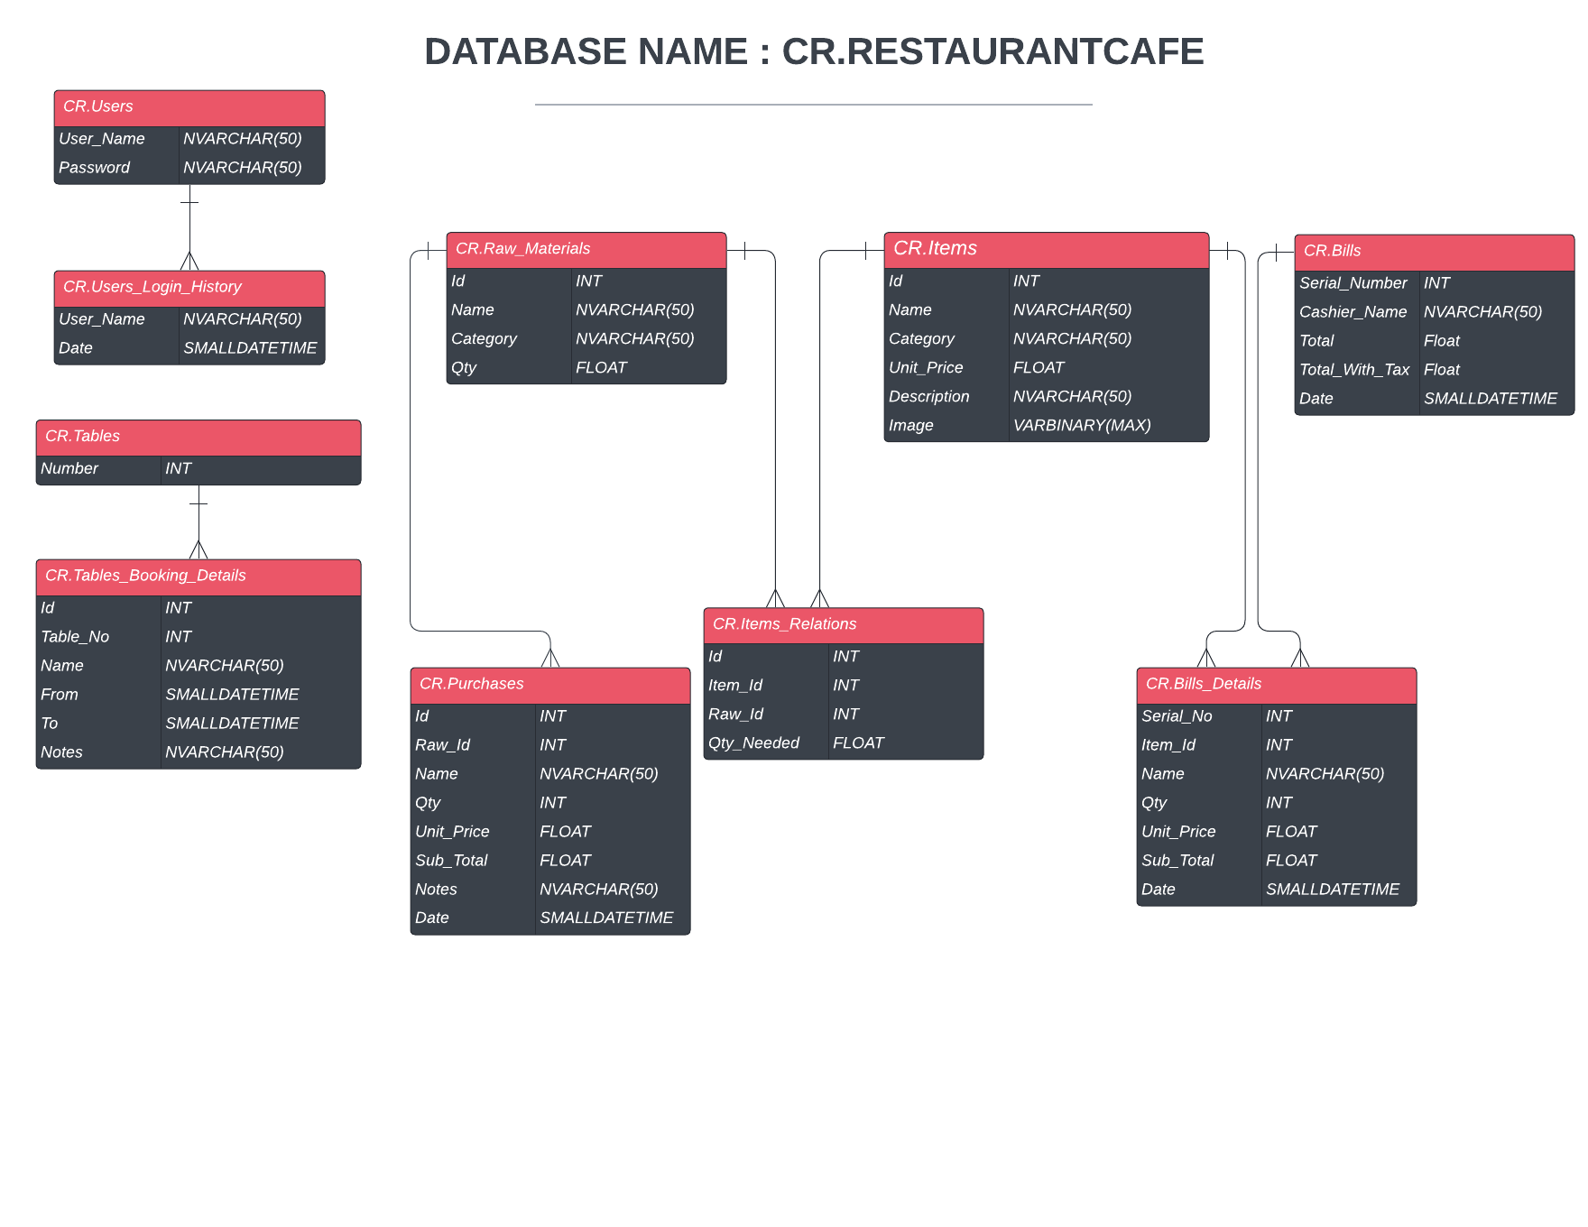

Slide 5
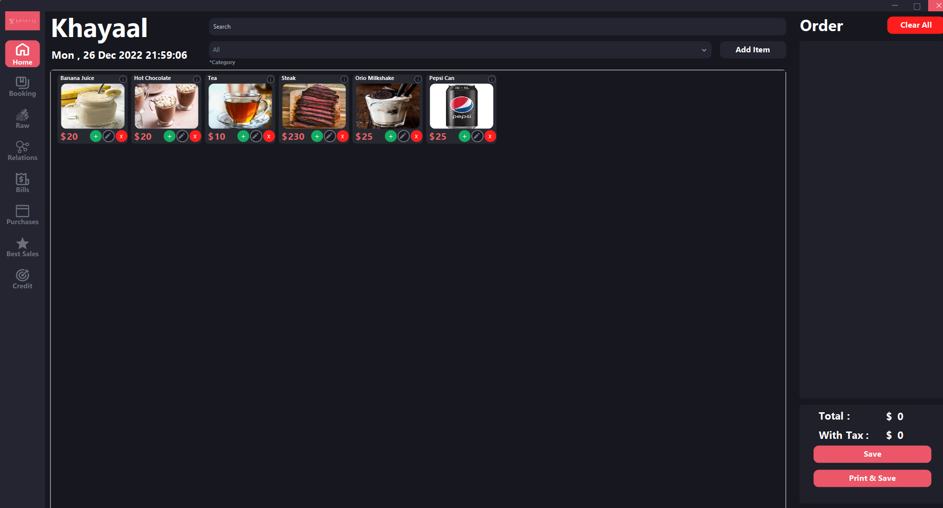

Slide 6
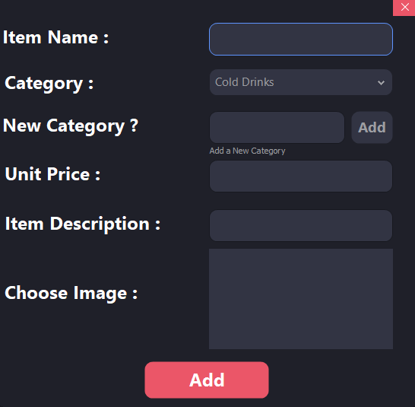
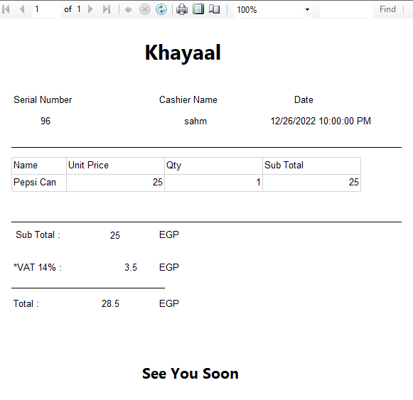

Slide 7
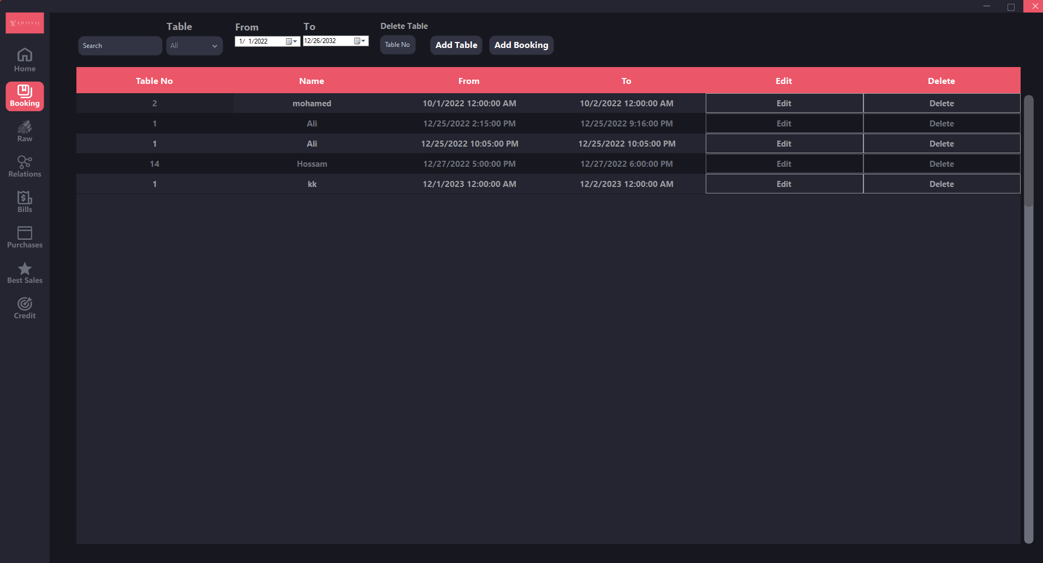

Slide 8
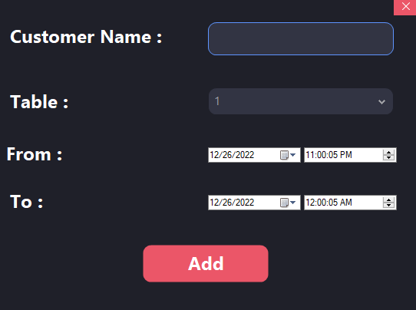

Slide 9
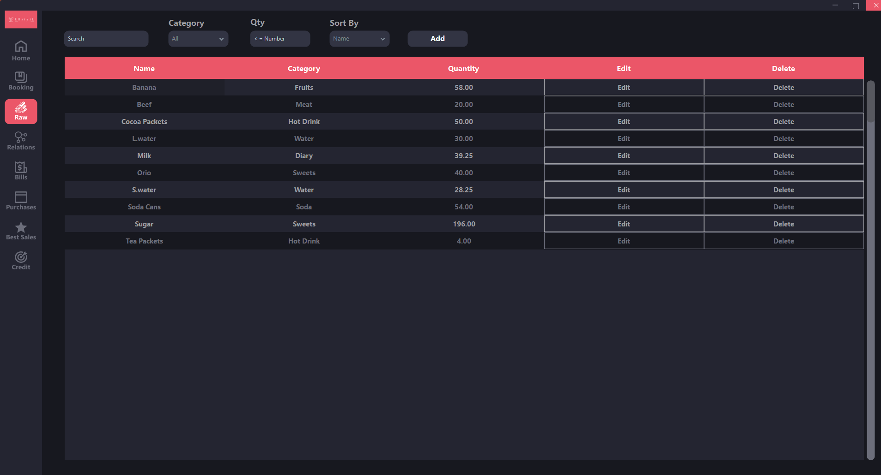

Slide 10
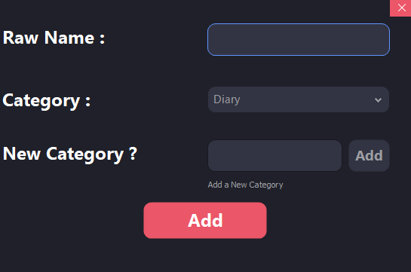

Slide 11
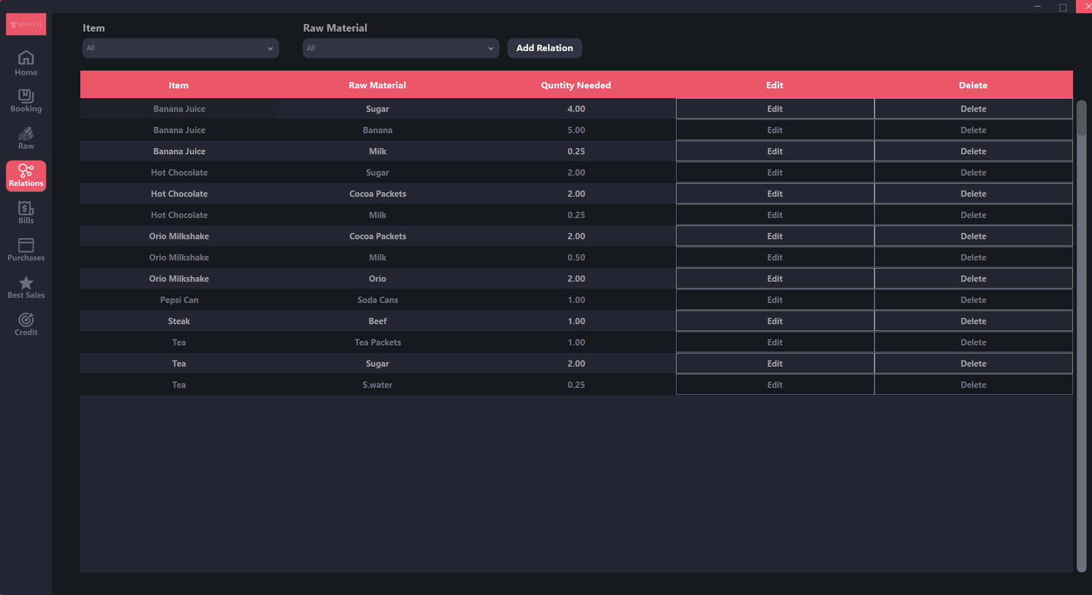

Slide 12
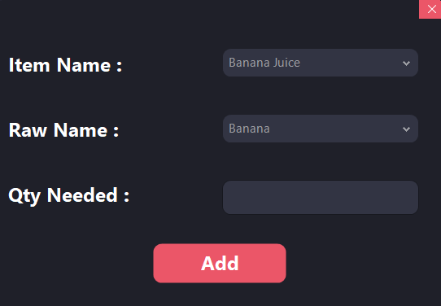

Slide 13
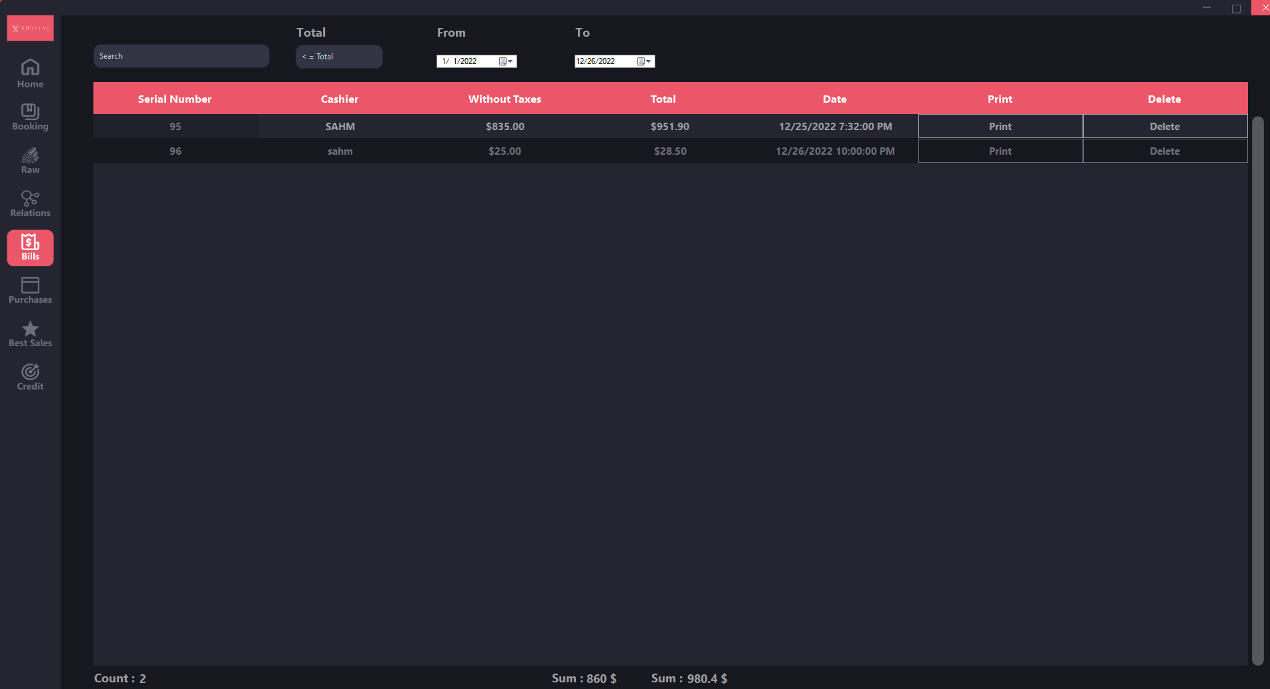

Slide 14
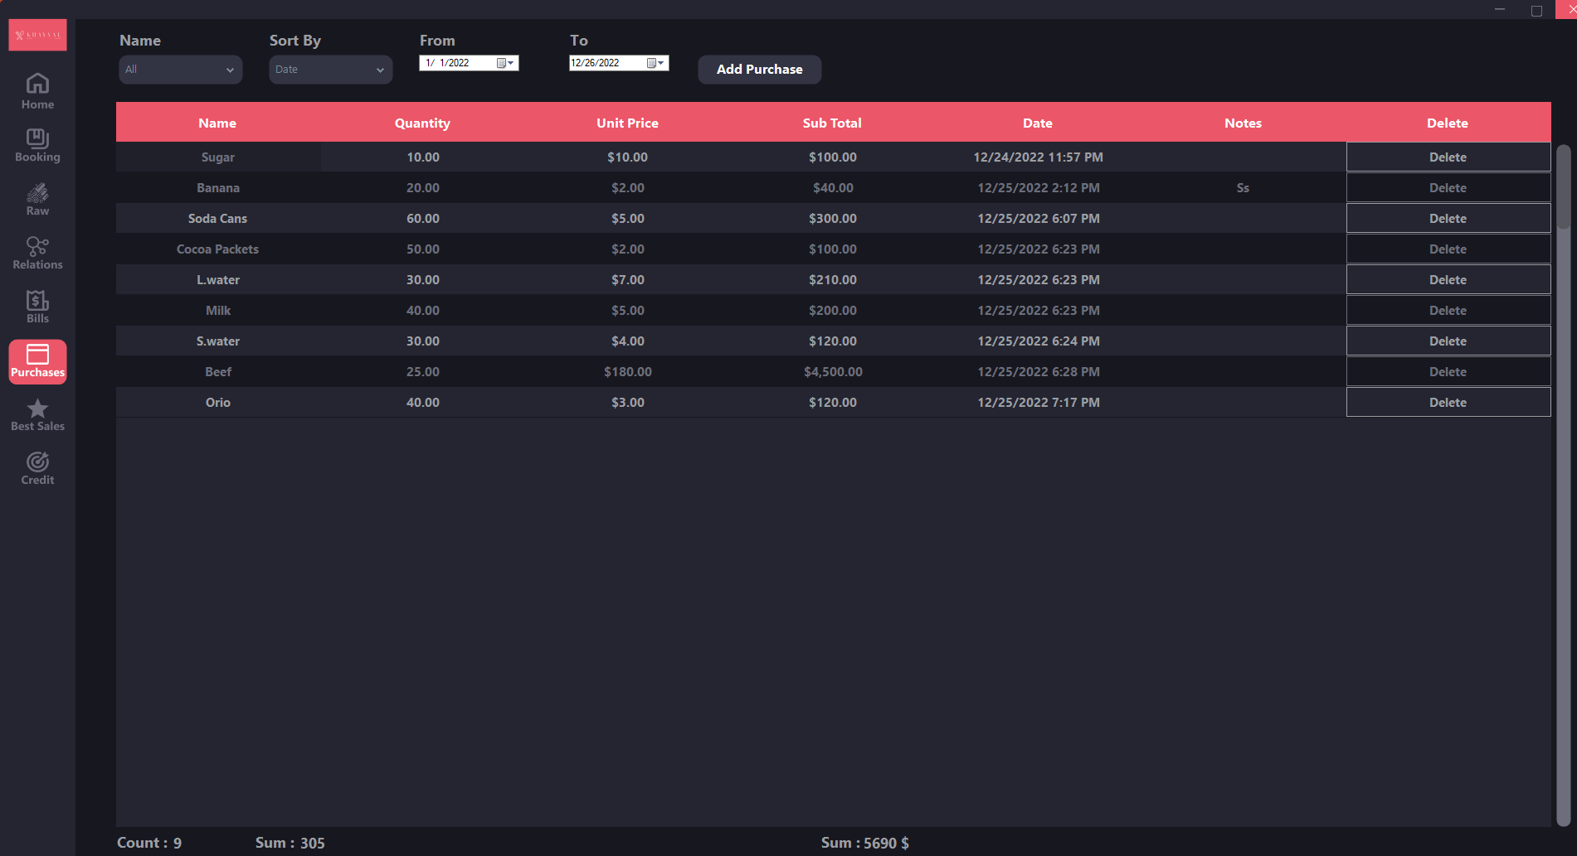

Slide 15
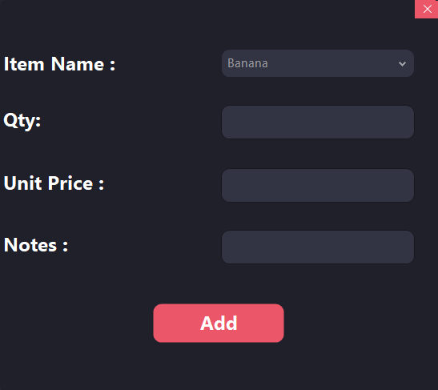

Slide 16
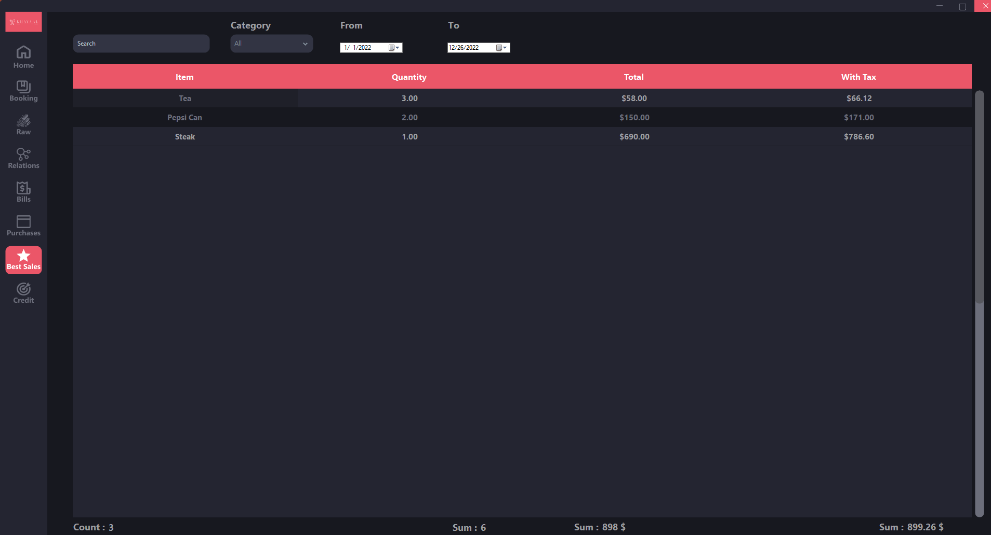

Slide 17
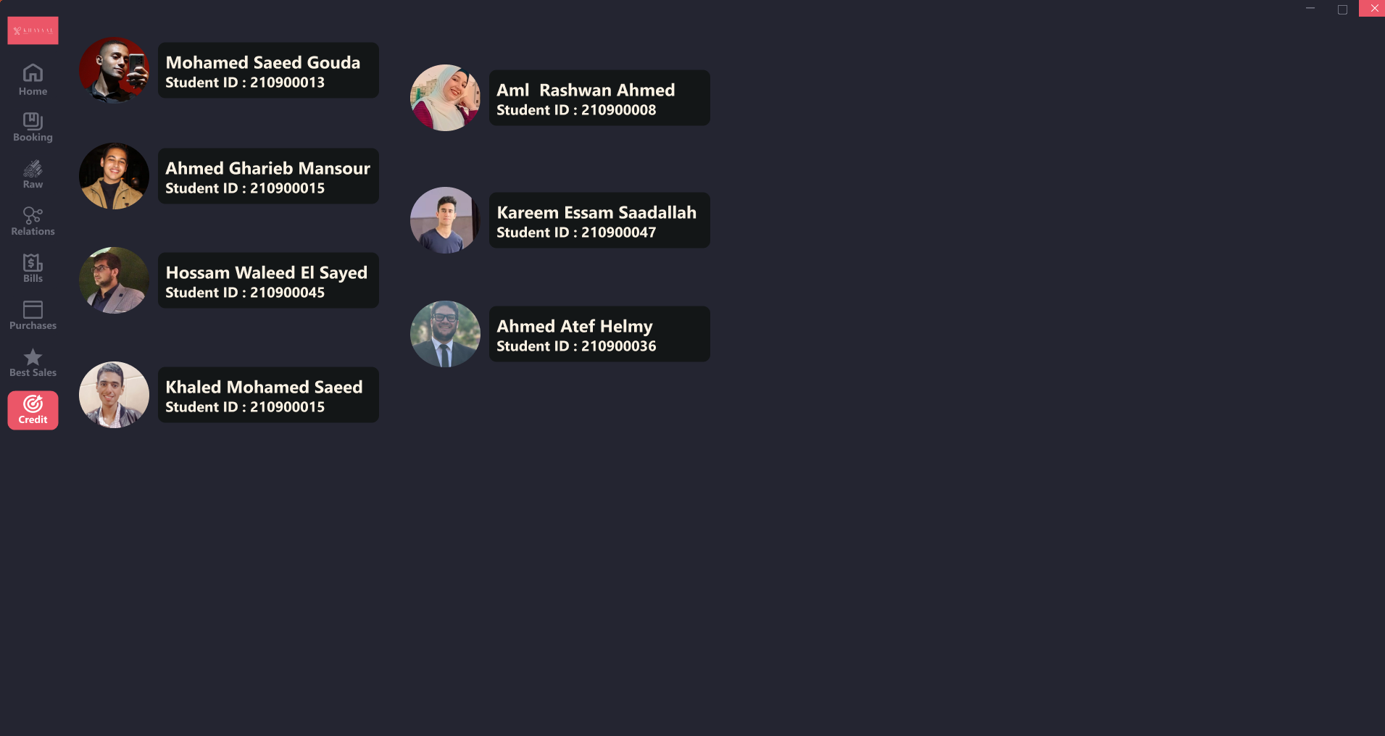

Slide 18
Report

Slide 19
About Khayaal:
Khayaal was a coincidence mixed with a bit of passion for food and cooking, So we
looked at the known systems which are made for restaurants and we wanted to make
a new one that is easy to use, fast and looks good and our journey began.
About Khayaal’s Name:
About the name it has a funny story, So us as team SAHM everyone of us wanted
different name and trust me they were very weird names, So we decided to use a roulette to choose the name and Khayaal was it.
About Khayaal’s Features:
With Khayaal you can track all of your Items’ prices, Materials stock and restocking them,
Your profits, Bills and you can book tables for your customers with the desired time.

Slide 20
Programming Languages Used:
1-C#
2-SQL
UI Used:
1-WinForms
2-Guna 2
3-Bunifu
Programs Used:
1-Visual Studio 2022
2-Microsoft SQL Server
Design Planning:
1- Figma
Team Work:
1-GitHub
Videos & Images:
1-DaVinci Resolve 18
4-Stream Elements
3-PhotoGimp
4-Krita

Slide 21

THANKS

